Slide 1



AlgoAdvisor:
A Meta-Learning Framework for Automated ML Algorithm Selection
Predicting the best-performing
machine-learning algorithm
for any dataset
PROJECT REPOSITORY
https://github.com/satyamchauhan/algoadvisor

Slide 2

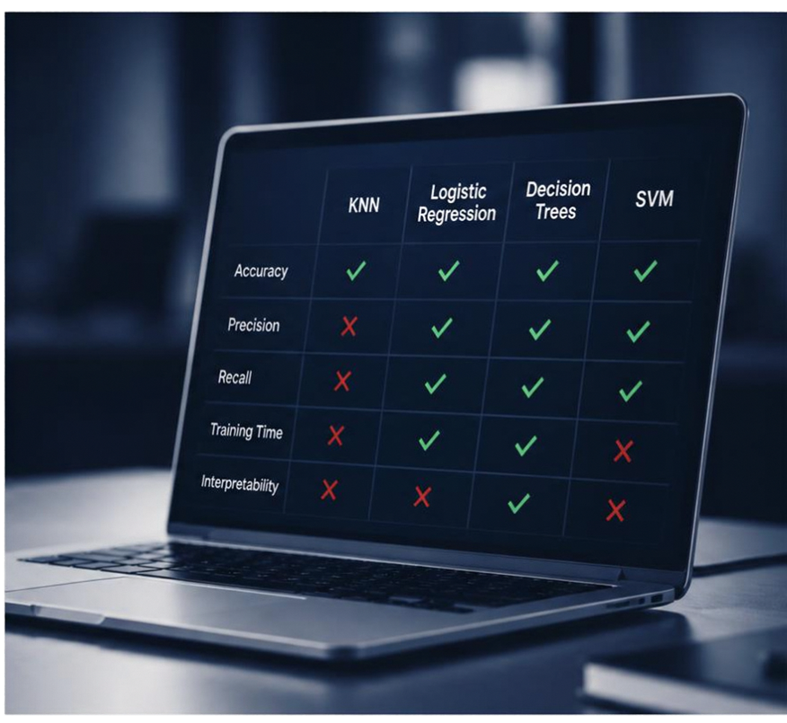
The Problem and Motivation
Choosing the right ML algorithm
is still a manual, inefficient process.
Practitioners try multiple algorithms
on every new dataset
KNN, logistic regression, decision trees, SVM
This trial-anderror approach
costs significant time and resources
AlgoAdvisor automates selection to
recommend the best algorithm upfront

Slide 3










Core Idea and Workflow Overview
1
2
3
4
5
Collect diverse public datasets
Extract
meta-features
Evaluate base algorithms
Train the
meta-model
Predict, train, and deliver
Gather 30–50
datasets covering a wide range of domains and characteristics.
Summarize each dataset using key statistics: samples, features,
class imbalance,
skewness, kurtosis,
correlations.
Train multiple algorithms on each dataset and label it with the
best-performing
algorithm.
Learn to map
meta-features to the best algorithm.
For a new dataset, predict the best algorithm, train it automatically, and return the model
and metrics.
AlgoAdvisor leverages meta-learning to recommend the best algorithm upfront,
saving significant time and resources.

Slide 4

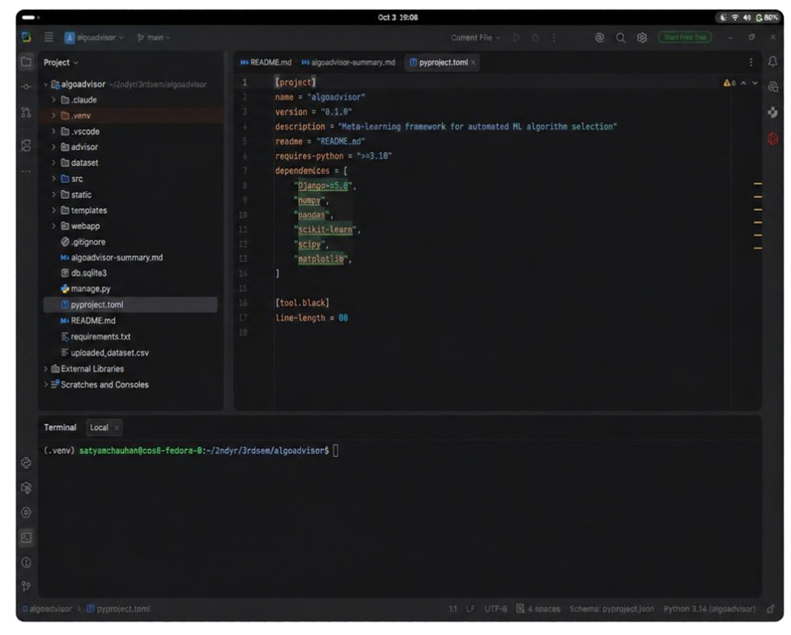

System Architecture and Key Features
Dataset meta-feature extraction
Profile each dataset with informative meta-features
Base algorithm trainer
Train and evaluate multiple candidate algorithms
Meta-model trainer and predictor
Learn performance patterns and predict the best algorithm
Automated pipeline for new datasets
End-to-end training and evaluation with minimal manual effort
Flexible by design
Easily configure meta-features and choose your algorithm pool

Slide 5










Evaluation Plan
We evaluate AlgoAdvisor by comparing its recommendation against strong baselines.
Key evaluation metrics
%
Frequency recommendation matches actual best algorithm
AlgoAdvisor
recommendation
Recommended algorithm accuracy
%
Frequency recommendation is in top two algorithms
All candidate algorithms
Average accuracy of
all candidate algorithms
Actual best
algorithm
Actual best
algorithm accuracy
Objective: reduce exhaustive testing without sacrificing accuracy.

Slide 6






Implementation Roadmap
Weeks 1–2
Dataset collection and metafeature selection finalization
Weeks 3–4
Base algorithm training and
performance recording
Weeks 5–6
Meta-model training and validation
Week 7
Integration of prediction and
automated training pipeline
Week 8
Testing, evaluation, and documentation

Slide 7










Expected Impact and Conclusion
Accelerates ML model selection on new datasets,
saving time and resources
Provides a novel
meta-learning approach
aligning with real-world
AutoML systems
01
02
A flexible framework
expandable with additional algorithms and meta-features
Open to your questions
and ideas
let’s discuss future opportunities and next steps
03
04

Slide 8
Thank You
Satyam Chauhan - CU25220023
Tushar – CU25220247
Dev Nautiyal – CU25220282
Akshit Saini – CU25220099

